Slide 1
CANCER PREDICTION USING ARTIFICIAL NEURAL NETWORKS
By
Bhavani prasad rao

Slide 2
Introduction 1. Breast Cancer is a 2nd cause of death among women 2. Medical Professionals can make mistakes in identifying disease 3. Machine Learning/ Artificial Intelligence can substantially improve diagnosis accuracy 4. ANN are widely used in healthcare domain for detecting cancer in earlier stage

Slide 3


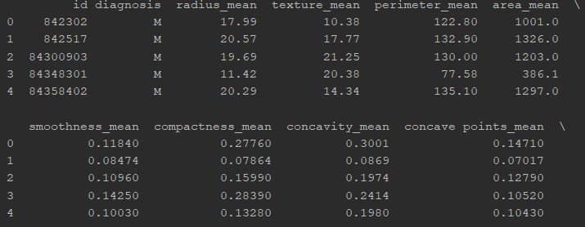



Dataset 1. Taken from UCI Machine Learning Repository 2. Dimension = 569 x 33 3. Binary labels (diagnosis) Benign(B)/Malignant(M) 4. Features related to tumor

Slide 4
Data Preparation: 1. Removed the unwanted features 2. Decoded the Binary labels 3. Split data into training(70%) and testing set (30%) 4. Feature Scaling- each feature will have mean = 0, SD = 1

Slide 5
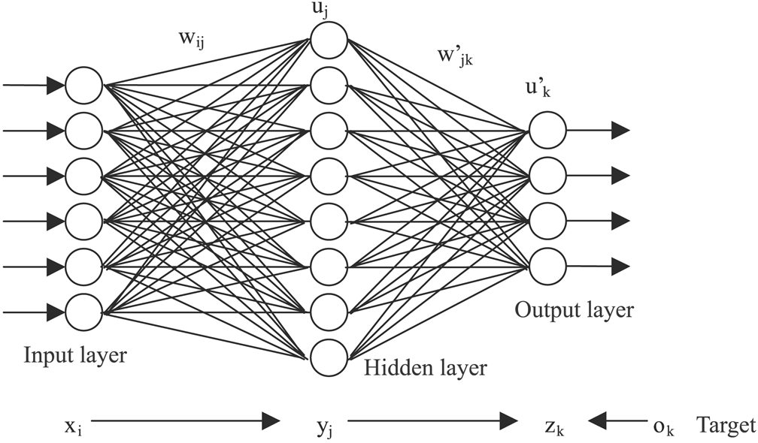
Model Artificial Neural Networks consists of 1. Input Layer 2. Hidden Layer 3. Output Layer

Slide 6
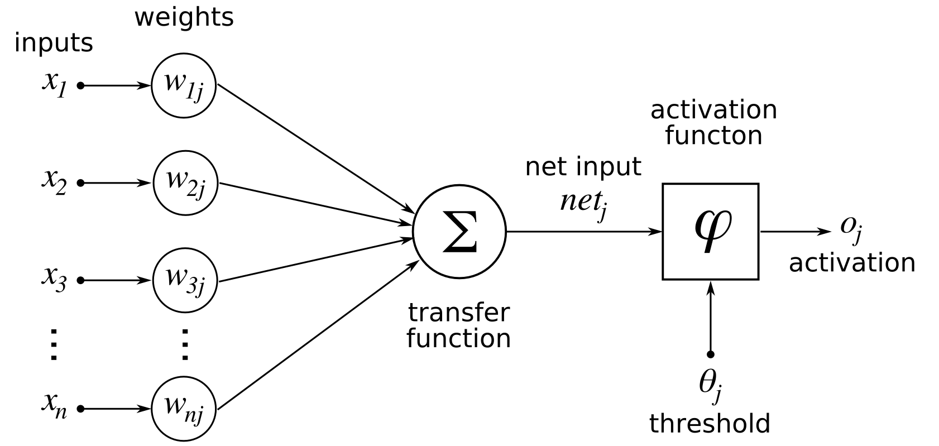
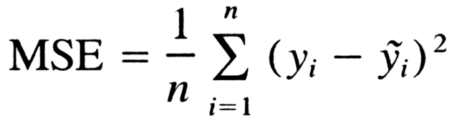
Objective function:

Slide 7
Approach: Network Initialization a) Data b) Parameters c) weights Training a) Forward Propagation b) Backward Propagation c) Updating the weights Testing & Evaluation a) Prediction b) Accuracy

Slide 8
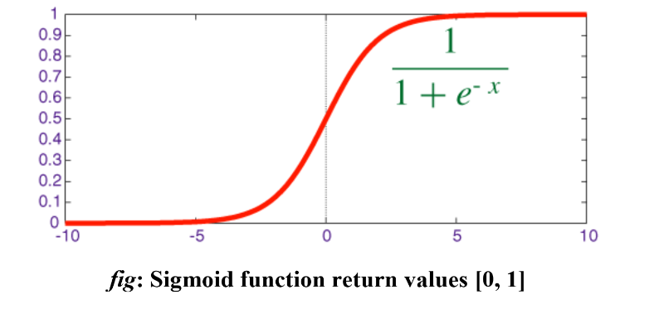
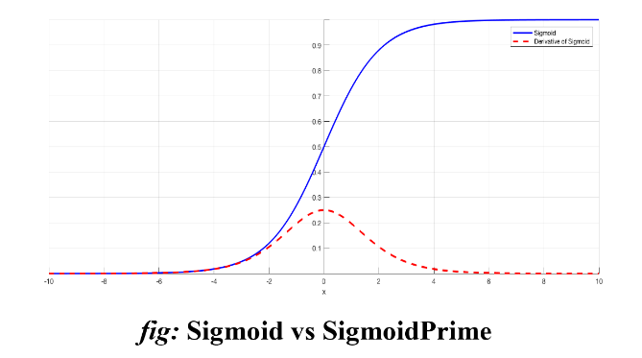
Activation Function

Slide 9

Widrow-Hoff or Delta Rule for Updating weight where: η = learning rate [0, 1] d = network error = Output - Predicted

Slide 10
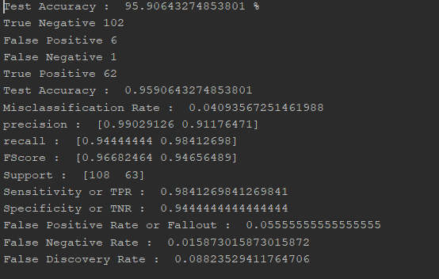
Results Test Accuracy = 95.90% Learning rate = 0.1(Optimal)

Slide 11
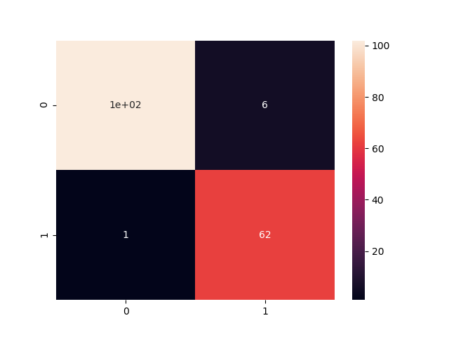
Performance Metrics Precision=[.99, .91] Recall = [.94, .98] Sensitivity = 0.98 Specificity= 0.94

Slide 12
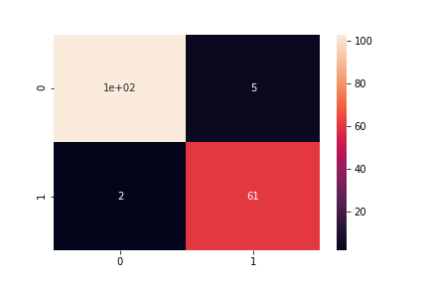
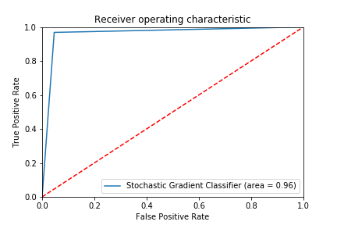
Improvements Stochastic Gradient Descent

Slide 13

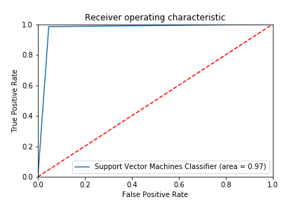
SVM – Linear Kernel (C=0.3)

Slide 14
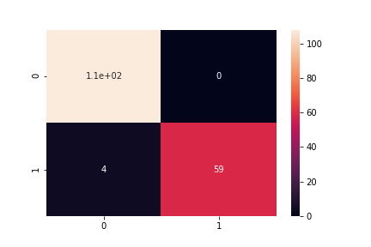
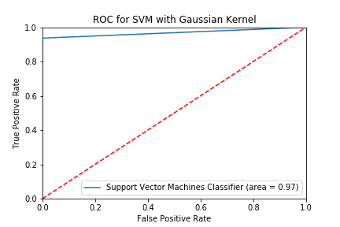
SVM with Gaussian Kernel C = 0.1, gamma = 0.02

Slide 15
Performance Metrics
Model | Accuracy (%) | Precision | Recall | F1- Score | Execution Time (sec) (Train & Predict)
ANN | 95.90 | 0.9117 | 0.9841 | 0.9465 | 30.7225
SGD | 94.74 | 0.9145 | 0.9523 | 0.9302 | 0.015621
SVM- linear | 96.49 | 0.9334 | 0.9841 | 0.9538 | 0.015629
SVM- Gaussian | 97.66 | 1.00 | 0.9365 | 0.9672 | 0.015619

Slide 16
Conclusion The development of this technique is promising as intelligent component in medical decision systems.

Slide 17
Future Work Will implement using Deep Learning and with ReLu activation function Will apply SGD, Adagrad to optimization

Slide 18
Question ?

Slide 19
References https://www.jyi.org/2017-december/2017/11/30/solving-cancer-the-use-of-artificial-neural-networks-in-cancer-diagnosis-and-treatment https://archive.ics.uci.edu/ml/datasets/Breast+Cancer+Wisconsin+(Diagnostic) http://www.extremetech.com/extreme/215170-artificial-neural-networks-are-changing-the-world-what-are-they

Slide 20
Thank You

